Slide 1
Expressions
Presented By S.R.Zameer

Slide 2
What is an Expression?
In any programming language, if we want to perform any calculation or to frame a condition etc., we use a set of symbols to perform the task. These set of symbols makes an expression. An expression can be defined as follows...
An expression is a collection of operators and operands that represents a specific value.

Slide 3
Contd…
operator is a symbol which performs a particular task like arithmetic operation or logical operation or conditional operation etc., Operands are the values on which the operators can perform the task. Here operand can be a direct value or variable or address of memory location.

Slide 4
Expression Types
Based on the operator position, expressions are divided into THREE types. They are as follows...
Infix Expression
Postfix Expression
Prefix Expression

Slide 5
Infix Expression
In infix expression, operator is used in between the operands. The general structure of an Infix expression is as follows...
Operand1 Operator Operand2

Slide 6
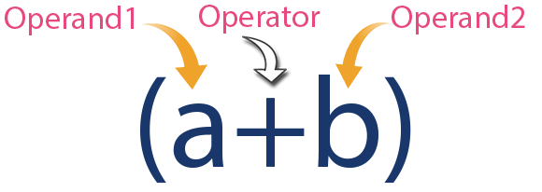
Example

Slide 7
Postfix Expression
In postfix expression, operator is used after operands. We can say that "Operator follows the Operands". The general structure of Postfix expression is as follows...
Operand1 Operand2 Operator

Slide 8
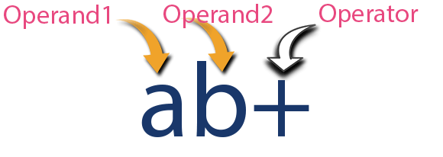
Example

Slide 9
Prefix Expression
In prefix expression, operator is used before operands. We can say that "Operands follows the Operator". The general structure of Prefix expression is as follows...
Operator Operand1 Operand2

Slide 10
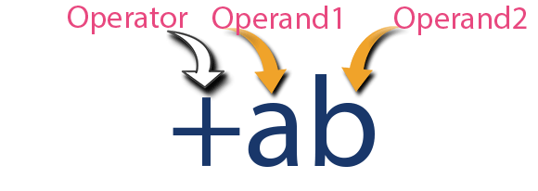
Example

Slide 11
Infix to Postfix Conversion
Any expression can be represented using three types of expressions (Infix, Postfix and Prefix). We can also convert one type of expression to another type of expression like Infix to Postfix, Infix to Prefix, Postfix to Prefix and vice versa.

Slide 12
Contd..
To convert any Infix expression into Postfix or Prefix expression we can use the following procedure...
Find all the operators in the given Infix Expression.
Find the order of operators evaluated according to their Operator precedence.
Convert each operator into required type of expression (Postfix or Prefix) in the same order.

Slide 13
Example
Consider the following Infix Expression to be converted into Postfix Expression...
D = A + B * C
Step 1 - The Operators in the given Infix Expression : = , + , *
Step 2 - The Order of Operators according to their preference : * , + , =
Step 3 - Now, convert the first operator * ----- D = A + B C *
Step 4 - Convert the next operator + ----- D = A BC* +
Step 5 - Convert the next operator = ----- D ABC*+ =
Finally, given Infix Expression is converted into Postfix Expression as follows...
D A B C * + =

Slide 14
Infix to Postfix Conversion using Stack Data Structure
To convert Infix Expression into Postfix Expression using a stack data structure, We can use the following steps...
Read all the symbols one by one from left to right in the given Infix Expression.
If the reading symbol is operand, then directly print it to the result (Output).
If the reading symbol is left parenthesis '(', then Push it on to the Stack.

Slide 15
Contd..
If the reading symbol is right parenthesis ')', then Pop all the contents of stack until respective left parenthesis is poped and print each poped symbol to the result.
If the reading symbol is operator (+ , - , * , / etc.,), then Push it on to the Stack. However, first pop the operators which are already on the stack that have higher or equal precedence than current operator and print them to the result.

Slide 16
Example
Consider the following Infix Expression...
( A + B ) * ( C - D )
The given infix expression can be converted into postfix expression using Stack data Structure as follows...

Slide 17
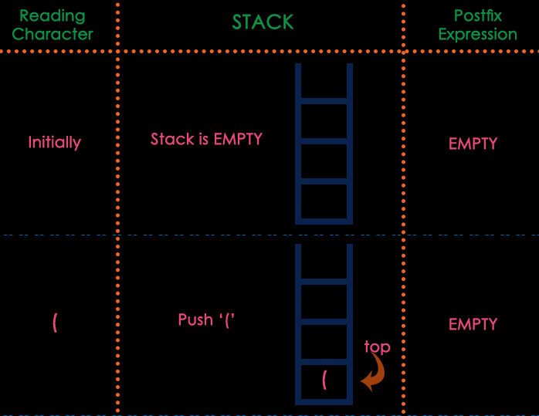

Slide 18
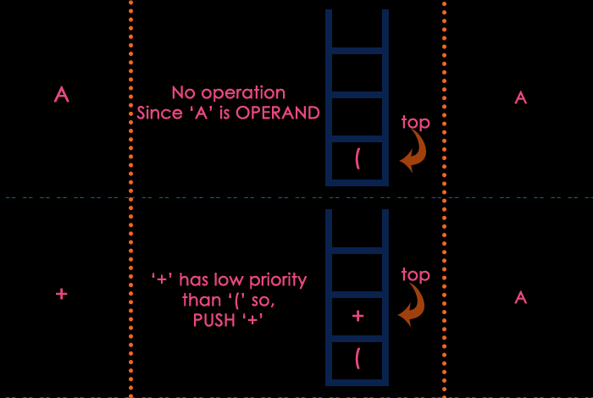

Slide 19
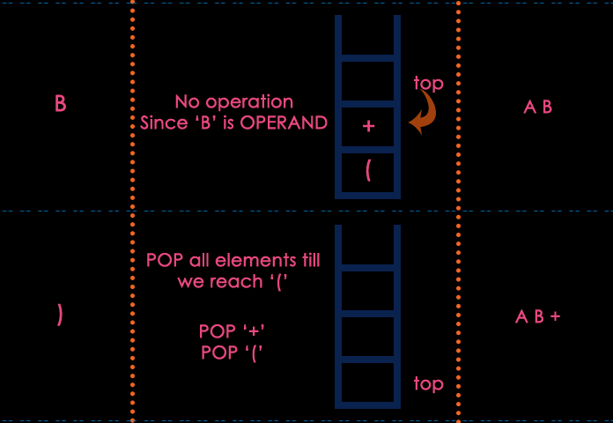

Slide 20
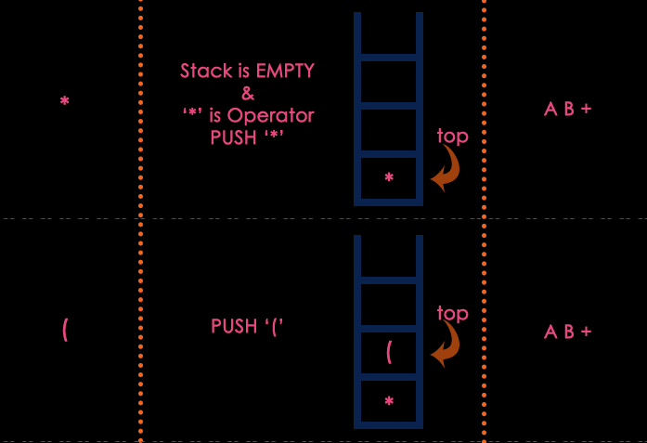

Slide 21
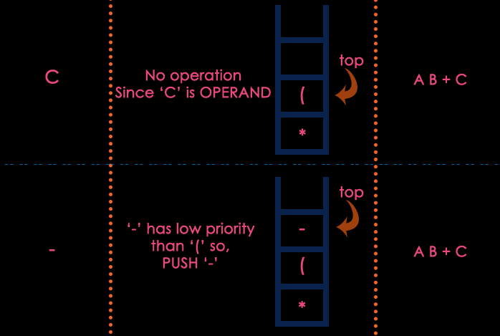

Slide 22
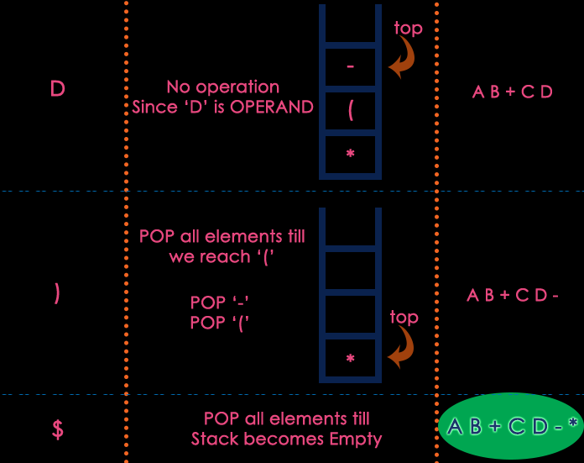

Slide 23
Postfix Expression Evaluation
A postfix expression is a collection of operators and operands in which the operator is placed after the operands. That means, in a postfix expression the operator follows the operands. Postfix Expression has following general structure...
Operand1 Operand2 Operator

Slide 24
Example

Slide 25
Postfix Expression Evaluation using Stack Data Structure
A postfix expression can be evaluated using the Stack data structure. To evaluate a postfix expression using Stack data structure we can use the following steps...
Read all the symbols one by one from left to right in the given Postfix Expression
If the reading symbol is operand, then push it on to the Stack.

Slide 26
Contd..
If the reading symbol is operator (+ , - , * , / etc.,), then perform TWO pop operations and store the two popped oparands in two different variables (operand1 and operand2). Then perform reading symbol operation using operand1 and operand2 and push result back on to the Stack.
Finally! perform a pop operation and display the popped value as final result.

